Slide 1


Hearing Protective Devices
Tri-Service Hearing Technician
4.2 Certification Course

Slide 2


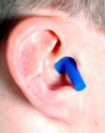
Hearing Protection Devices
Learning Objectives
2.4.1 Explain the relevance and importance of HPD fittings
2.4.2 Distinguish the types of hearing protective devices according to their characteristics, advantages and disadvantages
2.4.3 Outline the steps for fitting a patient with hearing protective devices
2.4.4 Explain the significance of the NRR in determining the effectiveness of hearing protectors
Tri-Service Hearing Technician 4.2 Certification Course
Notes:
Images Source: 1LT Angela Russo, Ft Carson

Slide 3
Hearing Protection Devices
Hearing Protection Selection Criteria
Tactical requirements
Degree of noise attenuation required to prevent any change of hearing thresholds
The work environment
Advantages and disadvantages
The best hearing protection device is one that will be used and worn correctly by the noise exposed individual
Tri-Service Hearing Technician 4.2 Certification Course

Slide 4
Hearing Protection Devices
Single Protection
Required in the following noise conditions, regardless of duration
  Steady-state Noise: >85 dBA TWA
  Impulse noise: >140 dBP
OSHA HPD use is required at an 85 dBA TWA if the employee has not received a baseline audiogram or if an STS has been identified
Provided by the Services
  USA/USAF provided by medical
  USN/USMC provided by the line unit
Tri-Service Hearing Technician 4.2 Certification Course

Slide 5
Hearing Protection Devices
Double Protection – Service Specific
USA
  Steady-state noise >103 to 108 dBA (TWA)
  Impulse noise >165 dBP
USN/USMC/USCG
  Steady-state noise >104 dBA (TWA)
  Impulse noise >160 dBP
USAF - when noise exposure is still hazardous with single HPD attenuation or on the flight line
In all cases while wearing double HPDs and hazardous noise exposure is still exceeded; administrative time limit controls may be implemented
Tri-Service Hearing Technician 4.2 Certification Course
Notes:
Briefly review administrative controls; time limits on noise hazard exposure; OSHA does not have double hearing protection requirements

Slide 6
Hearing Protection Devices
Noise Reduction Rating (NRR)
HPD are labeled with their noise reduction rating referred to as the NRR
The NRR is an attenuation value
  Determined under laboratory conditions
  Not accurate in a field environment; affected by fit, insertion technique, noise level in the work environment
OSHA/NIOSH have developed formulas to de-rate the NRR as a better estimate of real world protection
Tri-Service Hearing Technician 4.2 Certification Course
Notes:
Actual attenuation in a field environment is about half the NRR
Those who are fit appropriately and use the devices correctly will likely achieve attenuation values close to the published NRR

Slide 7
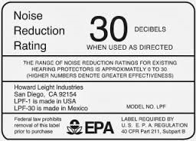
Hearing Protection Devices
Estimating HPD Attenuation
Noise Reduction Rating (NRR) measured in dBC
Spectral adjustment (subtract 7dB for use with dBA)
De-rating (OSHA recommendation)
  Service-specific de-rating
  Other organization recommendations
Personal Attenuation Rating (PAR)
Fit Testing of HPDs
Tri-Service Hearing Technician 4.2 Certification Course
Notes:
Noise Reduction Rating (NRR) is required by the Environmental Protection Agency (EPA) via 40 CFR Part 211, Subpart B, and is based on ANSI S3.19 (1974)
Because the NRR is measured in dBC, and dosimetry is typically measured in dBA, some spectral adjustments due to weighting scales differences is necessary (NRR-7dB subtraction – see next slide for example)
Estimating HPD attenuation
De-rating - The adjustment of the NRR to estimate actual field attenuation as opposed to attenuation measured in a laboratory
De-rating is an OSHA recommendation, but not a requirement
De-rating is only necessary on the required EPA-labeled NRR using the ANSI S3.19 (1974) standard; not necessary if using the most current ANSI S12.6 or S12.42
Air Force de-rating: per AFI 48-127: 50% earplugs, 25% earmuffs
Army de-rating: is not specified for the Army
Navy de-rating: Subtract 7 dB from HPD NRR; follows USMC de-rating if an STS is present
Marines de-rating: Subtract 7 dB from HPD NRR and divide by 2
NIOSH de-rating: 70% for pre-molded earplugs, 50% for formable earplugs and 25% for earmuffs (de-rating percentages reflect ease of fit)
OSHA de-rating: recommends de-rating the NRR by 50% when hearing protection is used in lieu of engineering and administrative controls
Personal Attenuation Rating: A measurement of the actual attenuation received by a user for a given fit
The most accurate method of determining appropriateness of a hearing protector (no de-rating necessary)
However, results reflect a specific fit
(Image: http://www.howardleight.com/hearing-protection/hearing-safety-glossary)

Slide 8
Hearing Protection Devices
OSHA HPD Attenuation De-rating
8 hour TWA noise exposure: 93 dBA
NRR of Hearing Protection: 29 dB
  Subtract 7 dB from NRR: 29 dB – 7 dB = 22 dB
  Divide by 2: 22/2 = 11 dB
Subtract 11 from the TWA: 93 dBA – 11 dB = 82 dB
Decide if 82 dB (known as the “Protected Exposure”) is below the PEL for noise
Tri-Service Hearing Technician 4.2 Certification Course
Notes:
Explain example for spectral adjustment and de-rating of the NRR
Know this formula for CAOHC exam

Slide 9
Hearing Protection Devices
Noise Reduction Rating - Double Hearing Protection
Double hearing protection (example: earplug and earmuff or helmet) does not double the NRR
  An earplug with a NRR of 25 dB worn with an earmuff protector that has a NRR of 25 dB does not give you 50 dB of noise reduction
Double protection provides only an additional 5 dB attenuation
Tri-Service Hearing Technician 4.2 Certification Course

Slide 10
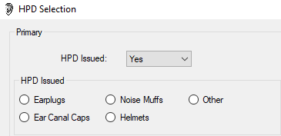
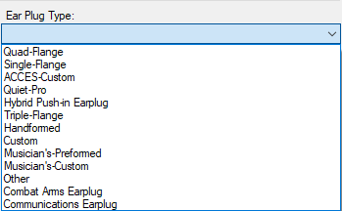
Hearing Protection Devices
DOEHRS-HC Hearing Protection Device Selection
Earplugs
  Preformed - fit by medical per ear
  Hand-formed
Noise muffs
Ear canal caps
Helmets
  Service specific
Other
  Tactical Communication and Protective Systems (TCAPS)
Tri-Service Hearing Technician 4.2 Certification Course
Notes:
Helmets are service specific in DOEHRS as a selection IAW patient DOD component
Carry HPDs in an earplug case, case may be used to assist in inserting HPD into ear
Primary HPD selection will limit double hearing protection drop down choices.

Slide 11
Hearing Protection Devices
Hearing Protection Device (HPD) Users
Protection required in hazardous noise
Speech becomes recognizable with time and practice
Machine noise and its operational characteristics become recognizable
HPDs may work loose (depending on type) and must be reinserted periodically for maximum effectiveness
Reduce work day exposure below 85 dBA/140 dBP using hearing protection or combination of hearing protection and administrative controls
Protected hearing is better than permanent hearing loss
Tri-Service Hearing Technician 4.2 Certification Course

Slide 12
Hearing Protection Devices
Earplug Fit
Fully insert HPD correctly
Occlusion effect - user’s voice should sound “deeper” to themselves
Voice should sound muffled
Fit each ear individually
Air-tight seal achieved
Resistance when you tug or try to remove the hearing protection device
Tri-Service Hearing Technician 4.2 Certification Course

Slide 13
Hearing Protection Devices
Otoscopic Examination/Lighted Ear Inspection (LEI)
Ensure ear canals are free of any obvious problems
  Can the TM be viewed
  Are there any obstructions/abnormalities
  What size HPD may be appropriate
Necessary step in fitting hearing protection
If something unusual or abnormal is discovered, seek further evaluation by a medical professional
Tri-Service Hearing Technician 4.2 Certification Course

Slide 14




Hearing Protection Devices
Triple Flange Earplug
3 color coded sizes
  Small (green)
  Medium (orange)
  Large (blue)
Use the earplug case to insert the triple flange earplug
Tri-Service Hearing Technician 4.2 Certification Course
Notes:
Review insertion technique; medically fitted
HPD insertion images source: APHC Wallet card, APHC VID
Image source: Army hearing protection devices via APHC VID

Slide 15
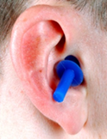

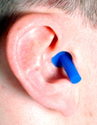
Hearing Protection Devices
Visualize a Good HPD Fit
Tri-Service Hearing Technician 4.2 Certification Course
Notes:
Left figure: the earplug is too big; Center figure the ear plug is too small; right figure is a properly fitted earplug; last flange flush with the opening of the ear canal
Images source: triple flange earplug insertion, APHC VID

Slide 16



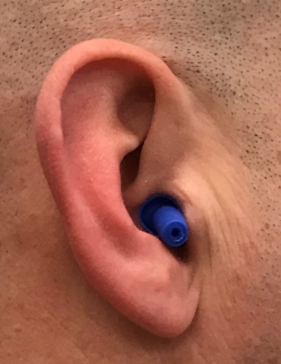
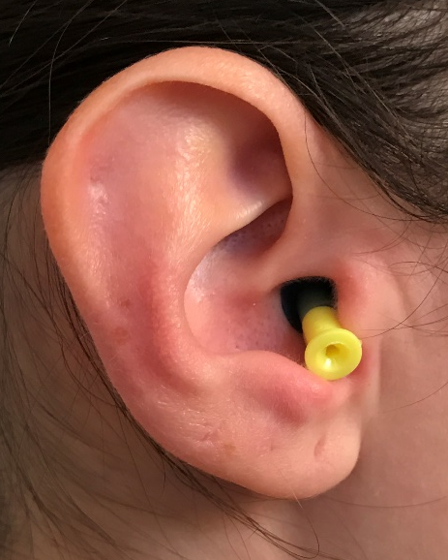
Hearing Protection Devices
Quad-Flange Earplug
Size may vary, depending on manufacturer
Tri-Service Hearing Technician 4.2 Certification Course
Notes:
Review insertion technique; medically fitted
Image Source: Quad flange earplug insertion via Dr. Kim Pierre, APHC Army Hearing Division
Image Source: Photo of Quad Flange earplugs via APHC VID and Army Hearing Division
Image Source: Quad Flange earplug poster via APHC VID

Slide 17
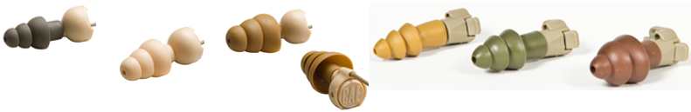
Hearing Protection Devices
Level Dependent Earplugs
Specialized filter contained within the earplug
Used differently depending on type of noise
Closed filter - maximum protection for both continuous noise (vehicles/machinery) and impulse noise (weapons fire)
Open Filter - little or no protection for continuous noise but will protect from impulse noise; level of protection will increase with the level of the impulse noise
Tri-Service Hearing Technician 4.2 Certification Course
Notes:
Open setting, level dependent earplugs will allow you to hear soft sounds, like speech, better but will not provide protection from continuous noise

Slide 18


Hearing Protection Devices
Level Dependent Earplugs Combat Arms/Battle Plugs
Sized
  Fit by medical professional
  Comes attached, same size as a set
Toggle switch selector
  Closed cap provides maximum protection from hazardous noise
  Open cap for increased situational awareness during weapons fire provides greater ability to hear speech and environmental sounds while providing protection from impulse noise
Tri-Service Hearing Technician 4.2 Certification Course
Notes:
Combat arms: small=green, regular=tan, large=brown
Image Source: Combat Arms Earplug insertion via Dr. Kim Pierre, APHC Army Hearing Division
Image Source: Photo of Combat Arms earplugs via APHC VID

Slide 19
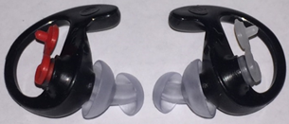
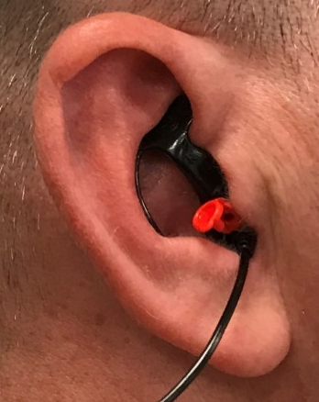
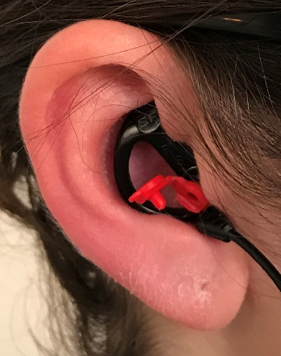
Hearing Protection Devices
Level Dependent Earplugs Sonic Defenders/Surefire
Specific to ear – right/left
  Right ear = red vent
  Left ear = clear vent
Cap open for weapons fire
Cap closed for continuous noise
Fit by medical professional
Tri-Service Hearing Technician 4.2 Certification Course
Notes:
Image Source: SureFire earplugs via Dr. Kim Pierre, APHC Army Hearing Division
Image Source: SureFire Earplug insertion via Dr. Kim Pierre, APHC Army Hearing Division

Slide 20
Hearing Protection Devices
Preformed Earplugs
Care, Maintenance and Replacement
Clean after each use with warm, soapy water
Rinse and dry thoroughly
Level-dependent earplugs
  Do not get the filter wet
  Remove the filter before cleaning the earplug with soap and water
Do not insert with soiled hands
Check plugs for correct size and any signs of deterioration
If unserviceable, must be refit with another pair
Tri-Service Hearing Technician 4.2 Certification Course

Slide 21
Hearing Protection Devices
Preformed Earplugs
Advantages
Effective protection with proper insertion depth
Durable, washable, reusable
Easily carried
Less expensive than ear muffs
Comfortable
Disadvantages
Medical fitting required
Frequent insertion may cause irritation
May work loose with jaw movement
Improper fit reduces effectiveness
Tri-Service Hearing Technician 4.2 Certification Course

Slide 22
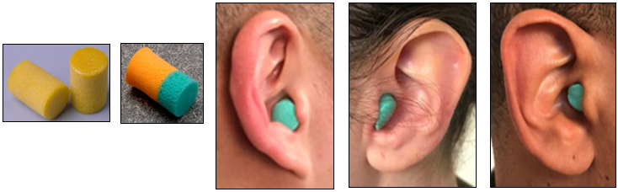
Hearing Protection Devices
Hand-formed Earplugs
Size, manufacture dependent
Plug will return to its original shape after being removed
Insert Hand-formed earplugs with clean hands
  Clean hands = free of debris or chemicals; any dirt, abrasive substances or chemicals can irritate the ear canal
Tri-Service Hearing Technician 4.2 Certification Course
Notes:
Image Source: Foam earplugs via Christina Graber, APHC VID
Image Source: Foam earplug insertion via Dr. Kim Pierre, APHC Army Hearing Division

Slide 23
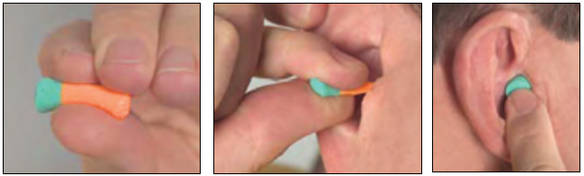
Hearing Protection Devices
Hand-formed Earplug Fitting Technique
Ensure a crease-free roll (thumb/index finger)
Insert 2/3 of plug into canal
Hold plug in place with finger until fully expanded
Tri-Service Hearing Technician 4.2 Certification Course
Notes:
When you have a good fit and seal, only the green color will be visible and the orange portion of the earplug will be completely in the ear canal
Image Source: Foam earplug insertion via Christina Graber, APHC VID

Slide 24
Hearing Protection Devices
Hand-formed Earplugs
Care, Maintenance and Replacement
Hand-formed earplugs are made from memory foam (polyurethane, etc.)
Washing Hand-formed earplugs will destroy the acoustic properties and render the earplug less effective
  Unless HPD is specifically designed to be washed/specific time for usage
May be designed to be one-time use – if so, dispose of earplug after a single use
Do not alter in any way (cut in half, trim tips for comfort, etc.)
Tri-Service Hearing Technician 4.2 Certification Course

Slide 25
Hearing Protection Devices
Hand-formed Earplugs
Advantages
Effective protection when properly inserted
Comfortable
Universal fit
Least expensive
Disadvantages
Requires practice to get a smooth cylinder shape with no creases or folds
Easily soiled
Cannot be used around corrosives or dangerous chemicals
One-time use
Tri-Service Hearing Technician 4.2 Certification Course

Slide 26
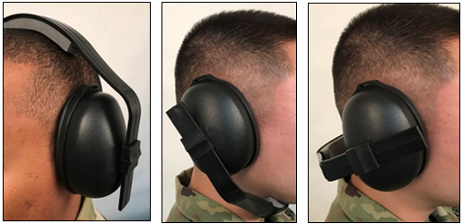
Hearing Protection Devices
Noise Muffs
Universal fit
Fitting techniques:
  Ear-cups must totally seal and enclose each ear
  Adjust headband for firm, comfortable fit
  Headband placement options vary
Can be incorporated into hard hat or helmet with high performance ear muffs
Tri-Service Hearing Technician 4.2 Certification Course
Notes:
Noise muffs: 3 positions
Image Source: Noise muff placement via Dr. Kim Pierre, APHC Army Hearing Division

Slide 27
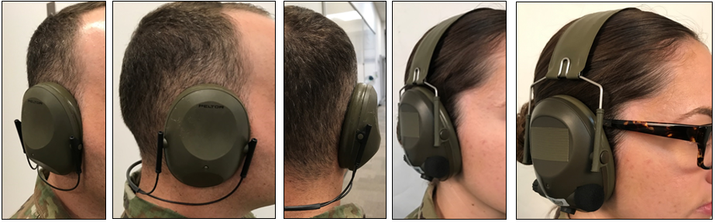
Hearing Protection Devices
Noise Muffs
Verify seal with or without glasses or goggles
Tri-Service Hearing Technician 4.2 Certification Course
Notes:
Image Source: Noise muff placement via Dr. Kim Pierre, APHC Army Hearing Division

Slide 28
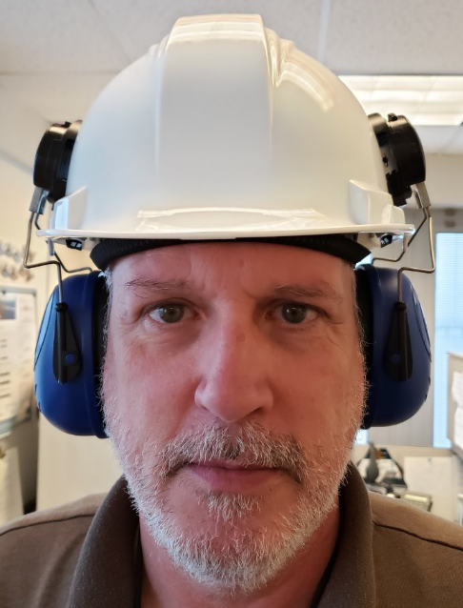
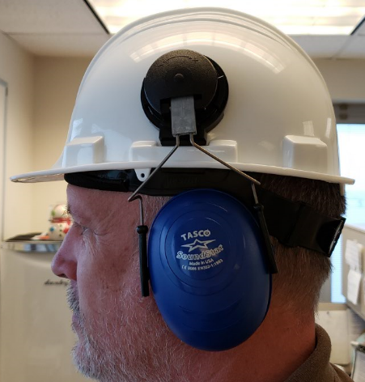
Hearing Protection Devices
Hard Hat with Noise Muffs
Verify seal
Tri-Service Hearing Technician 4.2 Certification Course
Notes:
Image Source: NMCPHC

Slide 29
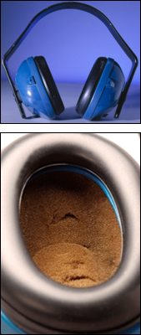
Hearing Protection Devices
Noise Muffs
Care, Maintenance and Replacement
Wipe ear-cup seals with moist cloth
Check seals frequently; replace if damaged
Replace cushion inserts (inside ear-cups) when foam deteriorates
Check for cracks or holes in ear-cups
Ensure adequate headband tension; replace if necessary
Modifications are prohibited
Tri-Service Hearing Technician 4.2 Certification Course
Notes:
Image Source: Noise muffs via Christina Graber, APHC VID
Image Source: Noise muffs via APHC VID

Slide 30
Hearing Protection Devices
Noise Muffs
Advantages
Universal fit
Good attenuation
Can be worn with earplugs
Medical fit not required
Easily cleaned
Add communications equipment and/or Active Noise Reduction (ANR) features
Disadvantages
Expensive
Bulky and heavy
Uncomfortable in heat and humidity
Hair, glasses, earring decrease effectiveness
Not easily carried
Tri-Service Hearing Technician 4.2 Certification Course

Slide 31

Hearing Protection Devices
Ear Canal Caps
Use only for short-term or intermittent exposures
Provide adequate hearing protection when hazardous noise levels are 95 dBA or less
Tips or end caps are placed at the opening of the ear canal and pushed into the ear canal until a snug seal is obtained
Can be worn over the head, under the chin or behind the neck
Tri-Service Hearing Technician 4.2 Certification Course
Notes:
Image Source: Ear canal caps insertion (orange) via Dr. Kim Pierre, APHC Army Hearing Division

Slide 32

Hearing Protection Devices
Ear Canal Caps
Advantages
Universal fit
Quickly inserted
Lightweight
Easily carried around the neck
Disadvantages
More expensive than earplugs
Uncomfortable after extended use
Limited attenuation
Poor headband tension greatly reduces effective protection
Tri-Service Hearing Technician 4.2 Certification Course
Notes:
Image Source: Ear canal caps and insertion (blue) via Christina Graber, APHC VID

Slide 33
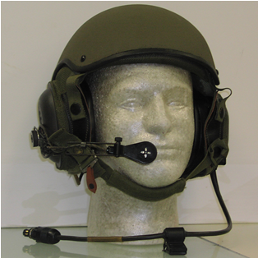

Hearing Protection Devices
Combat Vehicle Crewman (CVC) Helmet
CVC Helmets normally stay with the vehicle
Contains a helmet liner
  Vehicle Intercommunication System (VIS)
  Uses active noise reduction
Care and Maintenance
  Check ear-cup seals semi-annually
  Replace when cracked or broken
Eye protection may interfere with seal
Tri-Service Hearing Technician 4.2 Certification Course
Notes:
All helmets are issued by the unit
Image Source: CVC Helmet via USAARL, POC: William A. Ahroon, Ph.D., 334-255-6828
Image Source: Soldiers with CVC helmets via DVIDs

Slide 34
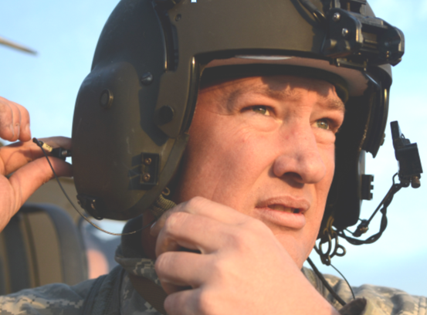
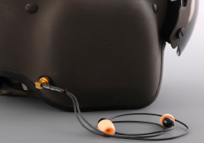
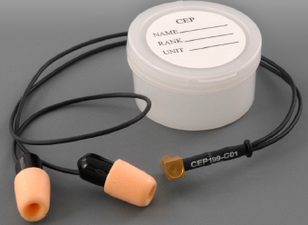
Hearing Protection Devices
Aviator Helmet
Aviator helmets normally stay with the person it is issued to
Aircrew retains night vision goggle (NVG) capability
Dismounted aircrew can communicate with aircraft
  Hearing enhancement while dismounted
Protection from high-level impulse noise
Improved situational awareness
Improved face-to-face communication
Usually worn with the Communication Earplug (CEP)
Tri-Service Hearing Technician 4.2 Certification Course
Notes:
Aviator Helmet HGU-56/P & CEP
Image Source: Aviator with helmet via DVIDs
Aviators Helmet HGU-56/P & CEP
Image Source: Aviator’s Helmet and CEP via USAARL, POC: William A. Ahroon, Ph.D.,

Slide 35
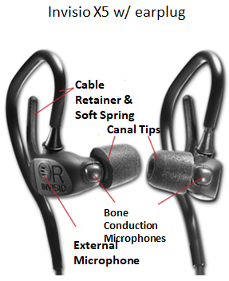
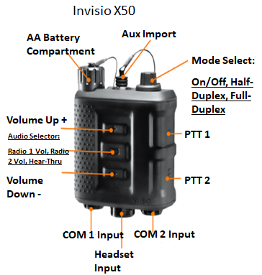
Hearing Protection Devices
Tactical Communication and Protection System (TCAPS)
Integrates hearing protection, communication equipment and amplification of environmental sounds
Tri-Service Hearing Technician 4.2 Certification Course
Notes:
Photos provided from Invisio, Nick Lafferty photographer

Slide 36

Hearing Protection Devices
Tactical Communication and Protection System (TCAPS)
Advantages
  Allows for amplification of soft sounds such as speech while providing hearing protection for loud sounds such as weapon fire
  HPD that can be used easily in tactical environments
  Availability in different types to suit unit/operator needs
Disadvantages
  Decreased localization and distance determination
Tri-Service Hearing Technician 4.2 Certification Course
Notes:
In addition to protection from hazardous noise, it also amplifies low level sounds, like a hearing aid, to increase the wearer’s situational awareness for low level sounds;
ANR is activated at 85 dBA, max output is 90 dBA, it is safe to wear for up to 8 hours in 115 dBA (equivalent to the sound of a jet taking off) and it is safe for impulse noises up to 165 dB peak sound pressure level; a digital compression circuit like those used in a hearing aid ensures that hazardous noise is not attenuated any more than necessary
Photo: Defense Imagery Digest

Slide 37
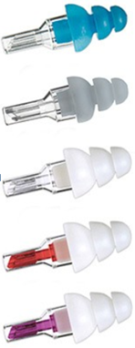
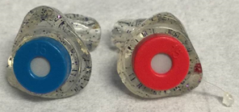
Hearing Protection Devices
Musician Earplugs
Custom Molded
  Molded to individual ear
  Various filters available
  Ear mold impression/special order required
Preformed
  Available in standard and large sizes
  Medical fit required
  NRR ~20 dB
Tri-Service Hearing Technician 4.2 Certification Course
Notes:
Designed for musicians and sound engineers, incorporate filters which yield relatively flat attenuation across frequencies; sound is not distorted in the same way conventional hearing protectors do; must be medically fit, custom molded earplugs and ear mold impressions with deep canal portion are needed; amount of attenuation depends on what instrument the musician plays and location in the band normally between 15-25 dB
Custom molded photo by Christina Graber- USAPHC VID; Preformed photo is from company catalog

Slide 38
Hearing Protection Devices
Summary
Selecting hearing protection
  Single protection
  Double protection
Noise reduction rating – HPD attenuation
HPD Types
HPD Fit
Otoscopic examination
HPDs care and maintenance
HPDs advantages and disadvantages
Tri-Service Hearing Technician 4.2.0.0 Certification Course

Slide 39
Hearing Protective Devices
? Questions ?
Tri-Service Hearing Technician
4.2 Certification Course

